Slide 1
MODULE 5 – INTRODUCTION TO PERIPHERAL INTERFACING - iI
Dr. P. Nirmala
Assistant Professor, Sr. Gr. I,
SENSE,
VIT Chennai Campus.

Slide 2
interfacing Adc with 8086
In most cases, PPI 8255 is used to interface the ADC to the microprocessor
ADC is considered as input device to the microprocessor that sends an initializing signal to the ADC to start the analog signal conversion
There is a pulse which is called the start of conversion (SOC) signal
A2D conversion is a slow process and the microprocessor has to wait until the conversion is over.
Once the conversion is over, the end of signal (EOS) is sent to inform the microprocessor about the same and the result is ready at the output buffer of ADC

Slide 3
Continued
Issuing SOC, reading EOC, getting the results are all done by PPI 8255
The time taken by the ADC for the conversion of the analog signal to digital signal is called conversion delay
It can range from a few microseconds to a few hundred milli seconds
Selection of appropriate ADC – speed, resolution and cost factor.

Slide 4
General algorithm for interfacing
Ensure the stability of the analog input given to the ADC
Issue SOC of ADC
Read EOC to mark the end of conversion
Read the digital output from the output buffer of ADC
The analog input must be a constant value from the start to end of conversion process
This is done using a sampling and hold circuit
The 8086 gives the hold signal to the sample and hold circuit

Slide 5
ADC 0808/0809
Successive optimization converters – one of the fastest techniques
Conversion delay is 100 microsecs for 640kHz
Do not need an external zero or full scale adjustments
8 input analog signals can be provided
Out of these 8 inputs, only 1 input can be selected for conversion by using address lines ADD A, ADD B and ADD C

Slide 6
Address lines for conversion
Analog I/P selected | Address lines
 | C | B | A
I/P 0 | 0 | 0 | 0
I/P 1 | 0 | 0 | 1
I/P 2 | 0 | 1 | 0
I/P 3 | 0 | 1 | 1
I/P 4 | 1 | 0 | 0
I/P 5 | 1 | 0 | 1
I/P 6 | 1 | 1 | 0
I/P 7 | 1 | 1 | 1

Slide 7
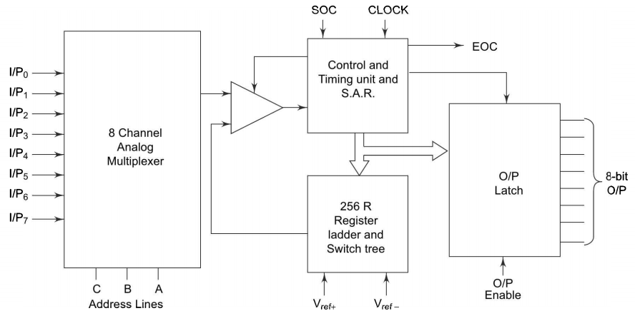
Block diagram of ADC 0808/0809

Slide 8
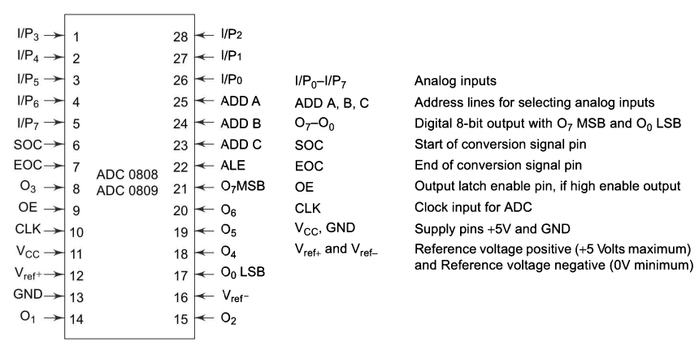
Pin diagram

Slide 9
Characteristic features
Unipolar digital convertors that can convert only positive analog voltages
They do not have internal hold and sample circuit
If a sample and hold circuit is needed, then each analog inputs must be connected with it.

Slide 10
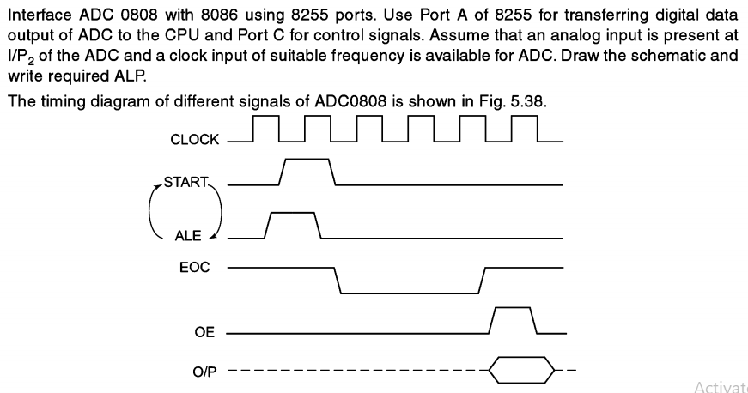
Example problem for interfacing

Slide 11
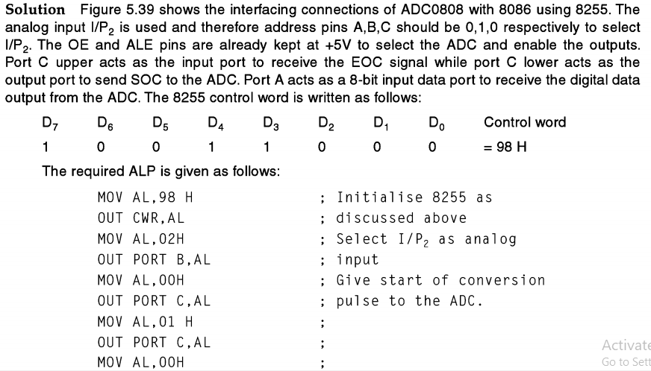

Slide 12
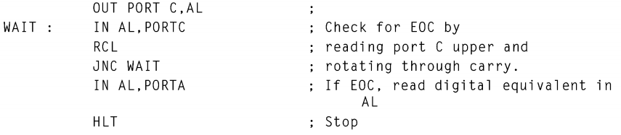
continued

Slide 13
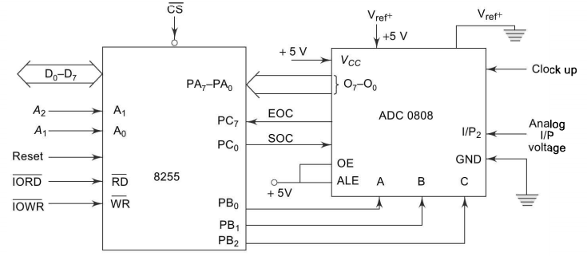
Interfacing 8086 with 0808

